Slide 1
Search for Top Squarks via All-hadronic Decay Channels with Heavy Object Tagging
Matthew Kilpatrick
Doctoral Candidate
Rice University

Slide 2
Outline
Standard Model
What is it?
Dark Matter
Why SUSY?
Compact Muon Solenoid
Different methods of detection
All-hadronic Top Squark Search
Kinematic Variables
Search region design
Background estimation

Slide 3
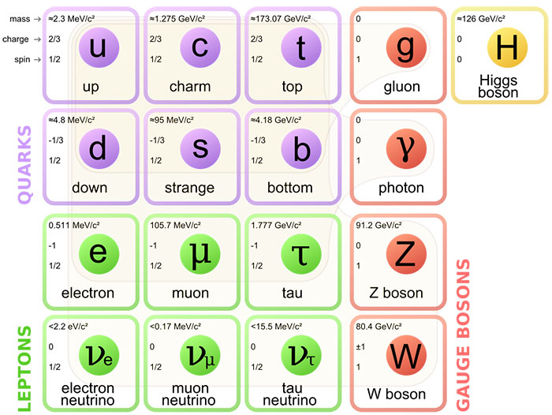
Standard Model

Slide 4

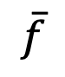
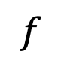
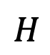
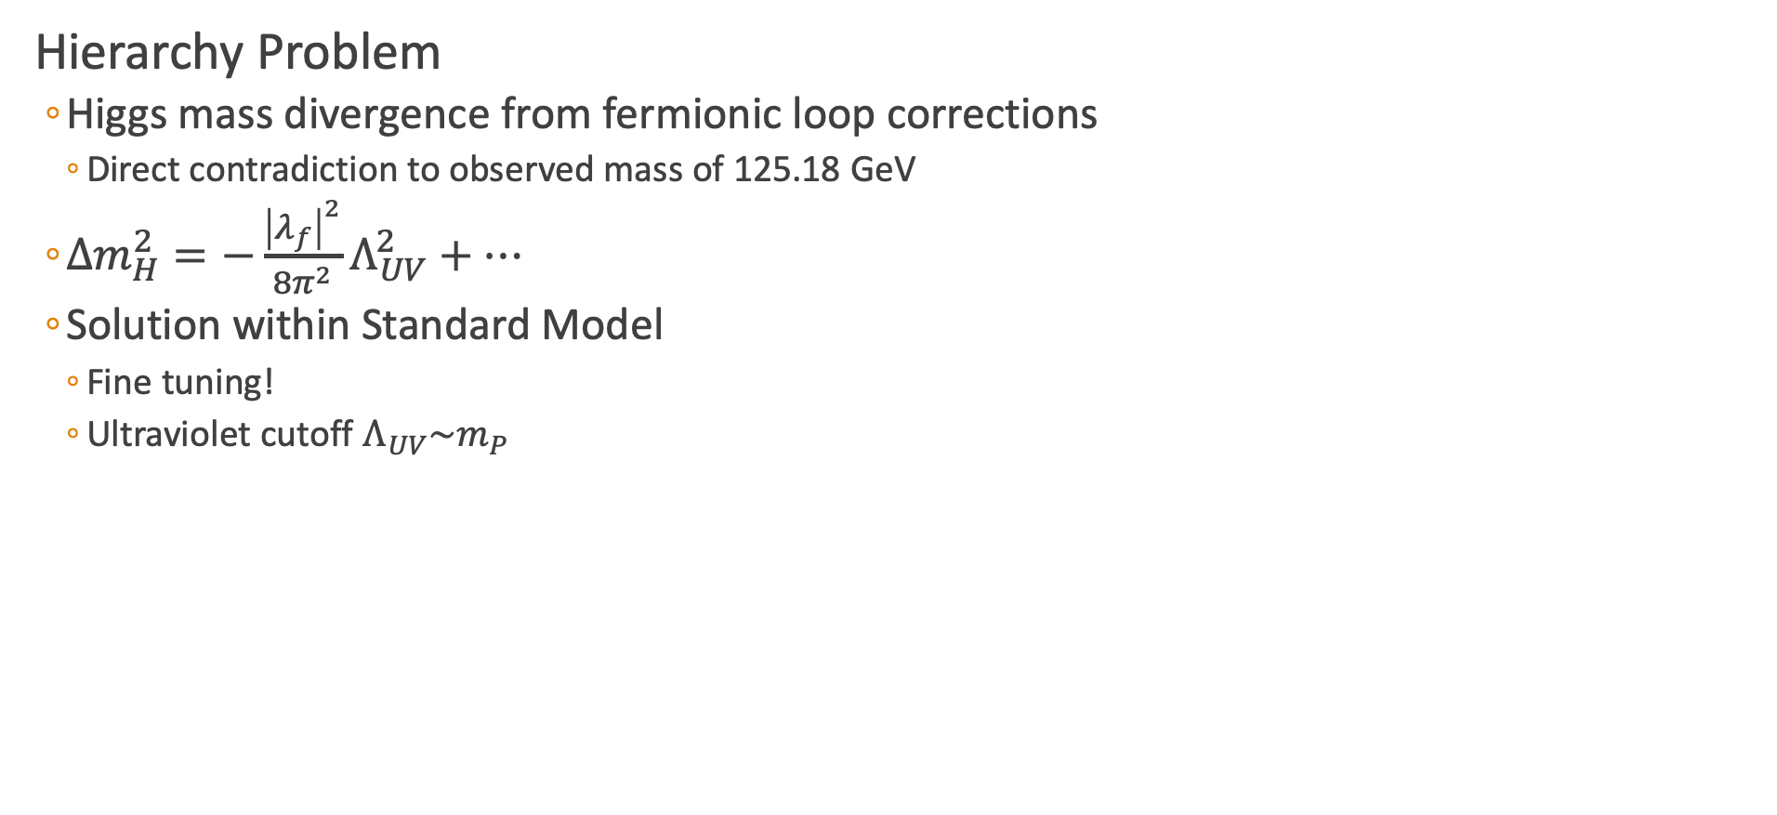
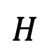
Hierarchy Problem
Hierarchy Problem
Higgs mass divergence from fermionic loop corrections
Direct contradiction to observed mass of 125.18 GeV
$Δm_{H}^{2}=−\frac{{\left|λ_{f}\right|}^{2}}{8π^{2}}Λ_{UV}^{2}+⋯$
Solution within Standard Model
Fine tuning!
Ultraviolet cutoff $Λ_{UV}\sim m_{P}$
$$f$$
$$H$$
$$H$$
$$\overline{f}$$

Slide 5
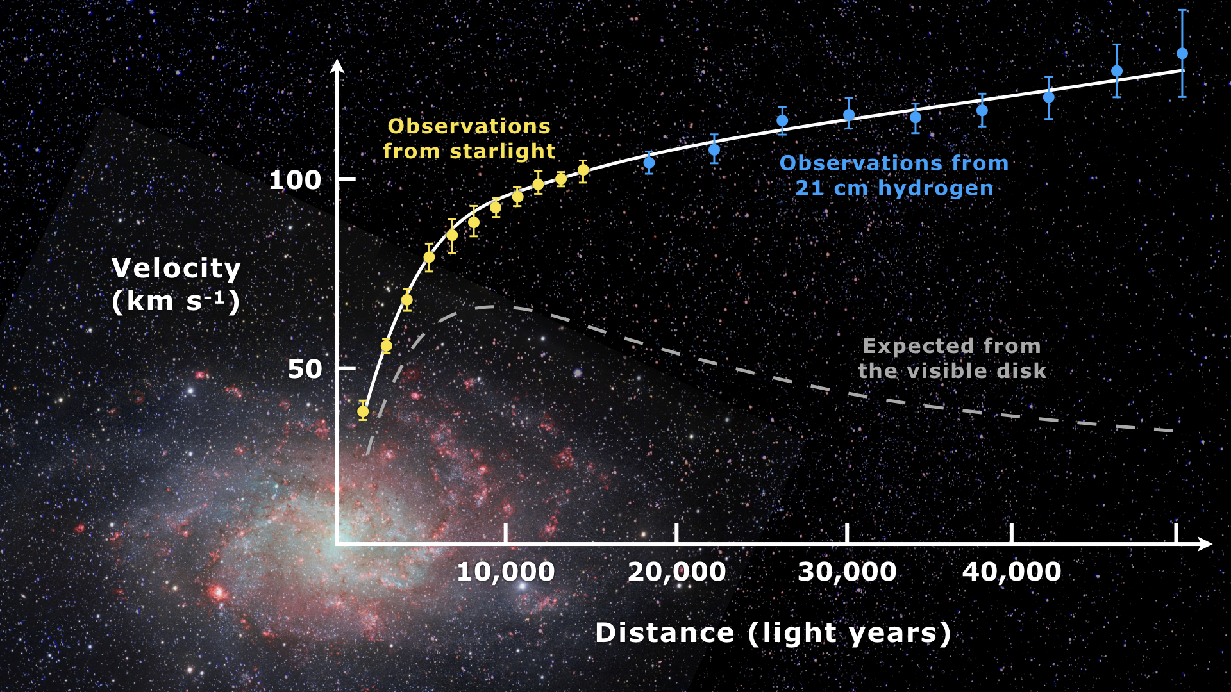
Dark Matter
Galactic Velocit Curves (Messier 33)
Radial velocity of galaxies is large
Not explainable with visible matter and current gravitational theories
Either:
Alternative theory of gravity
“Dark matter” interacting gravitationally
Gravitational Lensing
Mass curves spacetime
Deforms galaxies that move through
Use a gravitational lens methods to find total amount of matter
Disagrees with amount of visible matter
[1]
Notes:
Explain with a modified Newtonian gravity at low accelerations or Dark Matter

Slide 6
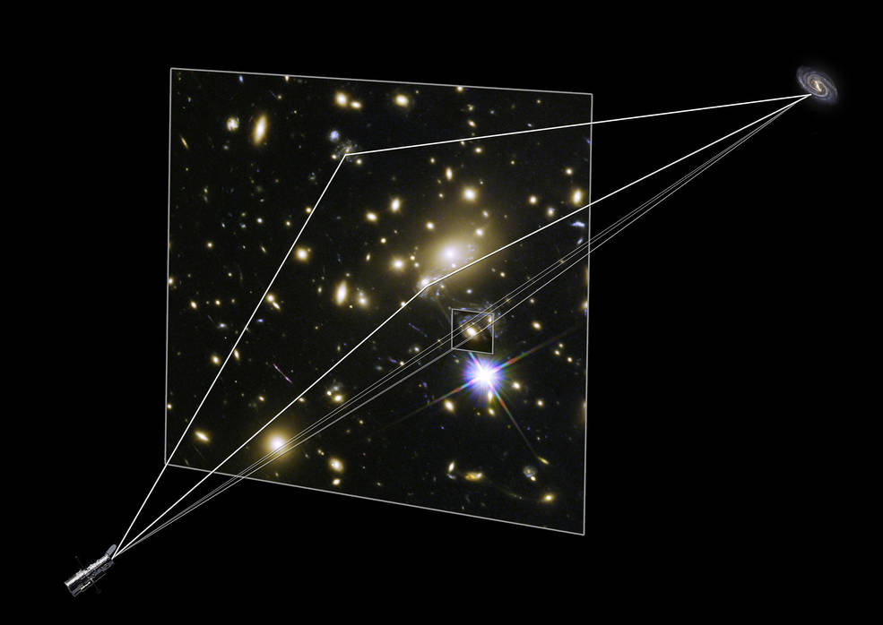
Dark Matter
Galactic Velocit Curves (Messier 33)
Radial velocity of galaxies is large
Not explainable with visible matter and current gravitational theories
Either:
Alternative theory of gravity
“Dark matter” interacting gravitationally
Gravitational Lensing
Mass curves spacetime
Deforms galaxies that move through
Use a gravitational lens methods to find total amount of matter
Disagrees with amount of visible matter
[1] [2]

Slide 7
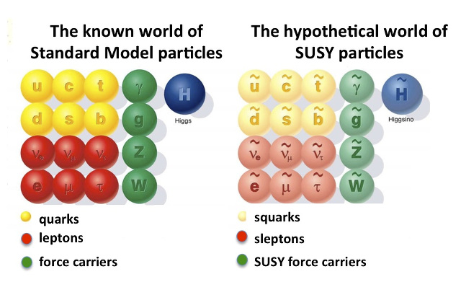
What does Supersymmetry potentially solve?
What is Supersymmetry?
Fermion-bosonic partnership
For every fermion there is a boson partner, and vice-versa
Exact same quantum numbers except spin
Where is the ”selectron”?
Supersymmetry must be broken!
How does this solve things?
What should we search for?

Slide 8
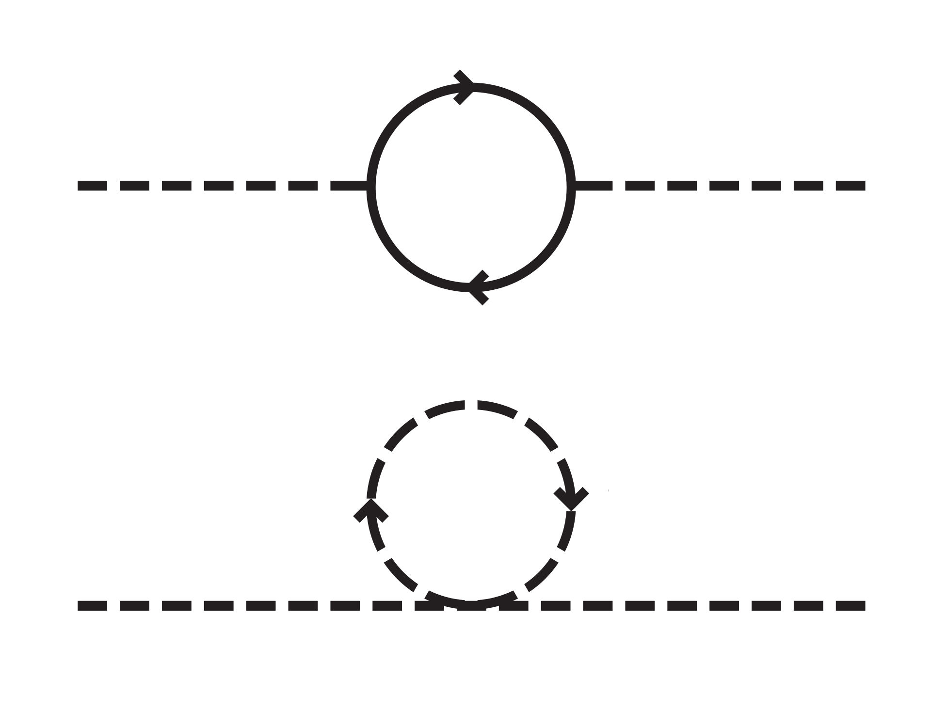
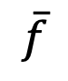
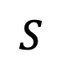
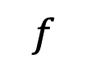
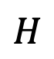
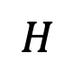
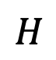
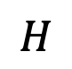
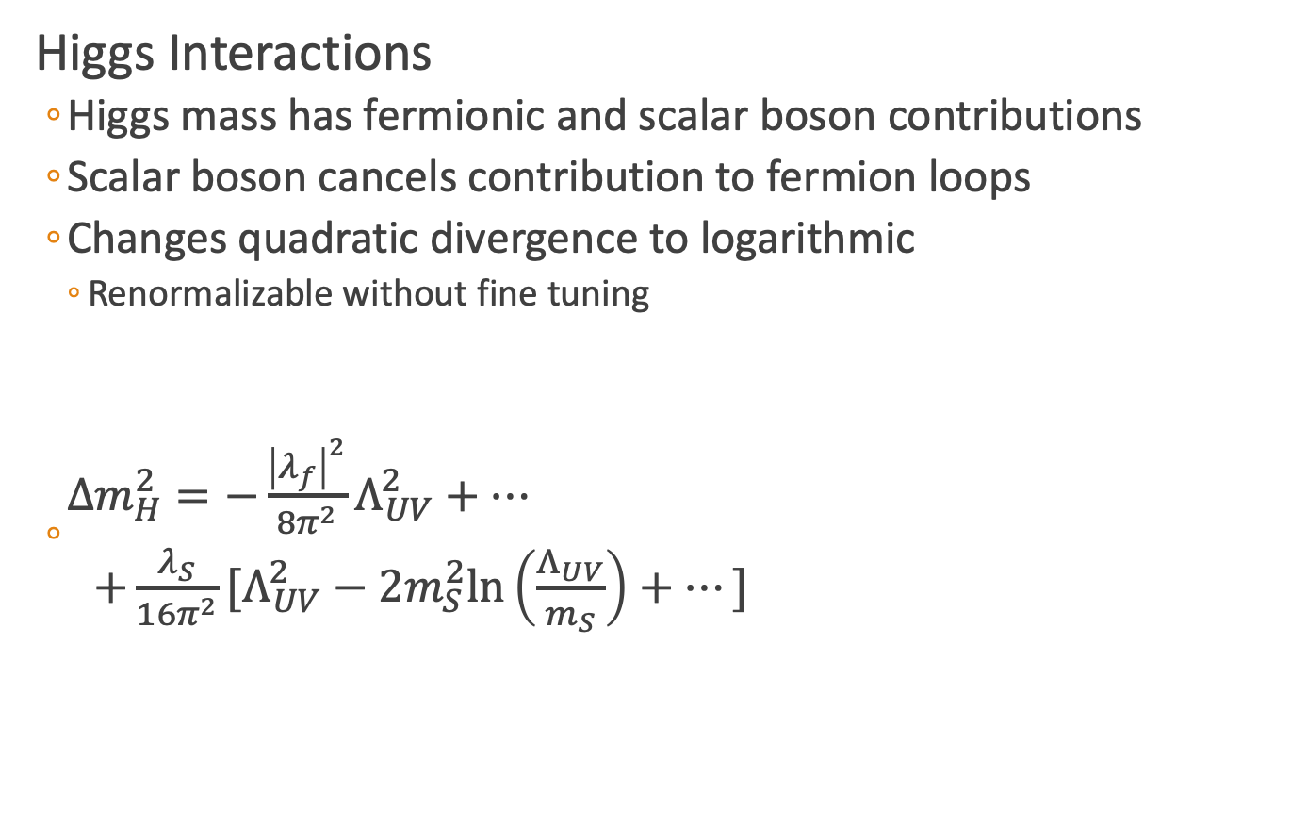
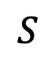
Hierarchy Solution
Higgs Interactions
Higgs mass has fermionic and scalar boson contributions
Scalar boson cancels contribution to fermion loops
Changes quadratic divergence to logarithmic
Renormalizable without fine tuning
$\begin{matrix}Δm_{H}^{2}=−\frac{{\left|λ_{f}\right|}^{2}}{8π^{2}}Λ_{UV}^{2}+⋯ \\ +\frac{λ_{S}}{16π^{2}}[Λ_{UV}^{2}−2m_{S}^{2}\text{ln}\left(\frac{Λ_{UV}}{m_{S}}\right)+⋯] \end{matrix}$
$$f$$
$$H$$
$$H$$
$$\overline{f}$$
$$S$$
$$S$$
$$H$$
$$H$$
Notes:
P_R = (-1)^3(B-L)+2s

Slide 9
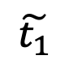
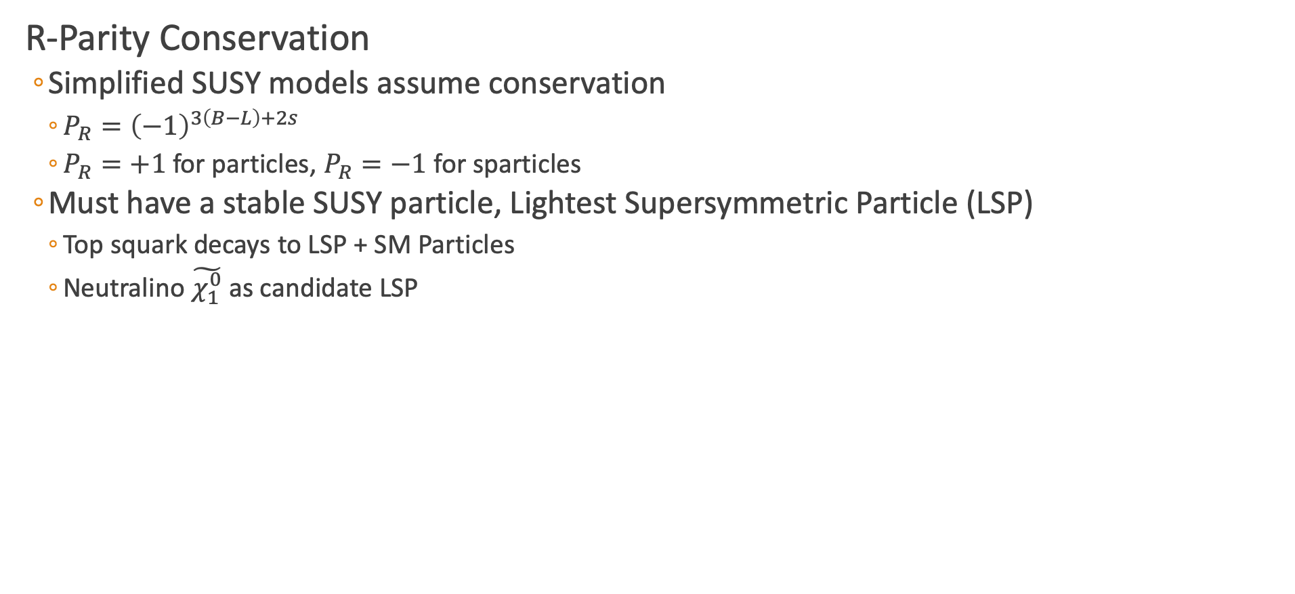
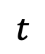
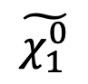
Dark Matter Candidate
R-Parity Conservation
Simplified SUSY models assume conservation
$P_{R}={\left(−1\right)}^{3\left(B−L\right)+2s}$
$P_{R}=+1$ for particles, $P_{R}=−1$ for sparticles
Must have a stable SUSY particle, Lightest Supersymmetric Particle (LSP)
Top squark decays to LSP + SM Particles
Neutralino $\tilde{χ_{1}^{0}}$ as candidate LSP
$$t$$
$$\tilde{t_{1}}$$
$$\tilde{χ_{1}^{0}}$$

Slide 10
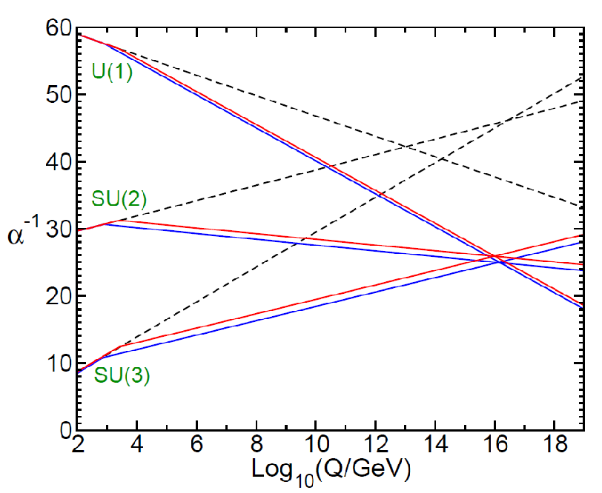
Grand Unified Theory
Unification of the Gauge Couplings
SUSY allows for EM, Weak, and QCD to unify at large energy scales
Notes:
Two loop renormalization group evolution of the inverse gauge couplings $α_{a}^{−1}(Q)$ in the SM (dashed) and MSSM (solid). In the MSSM, the sparticle masses are treated as a common threshold varied between 750 GeV and 2.5 TeV.
QED: $α=\frac{e^{2}}{4πε_{0}ℏc}$
QCD:

Slide 11
Outline
Standard Model
What is it?
Dark Matter
Why SUSY?
Compact Muon Solenoid
Different methods of detection
All-hadronic Top Squark Search
Kinematic Variables
Search region design
Background estimation

Slide 12
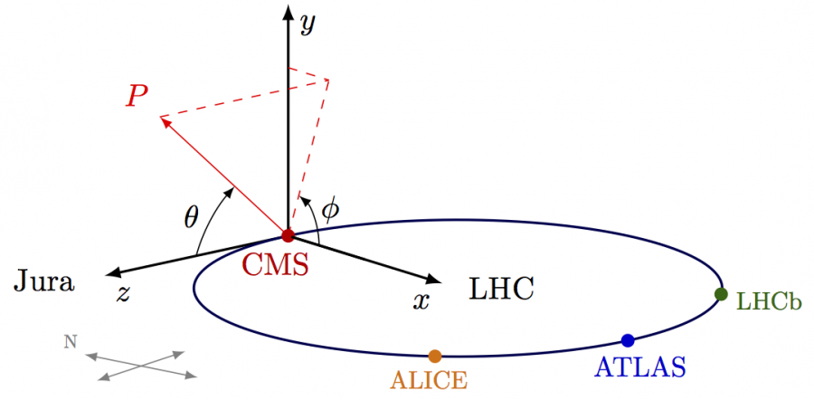
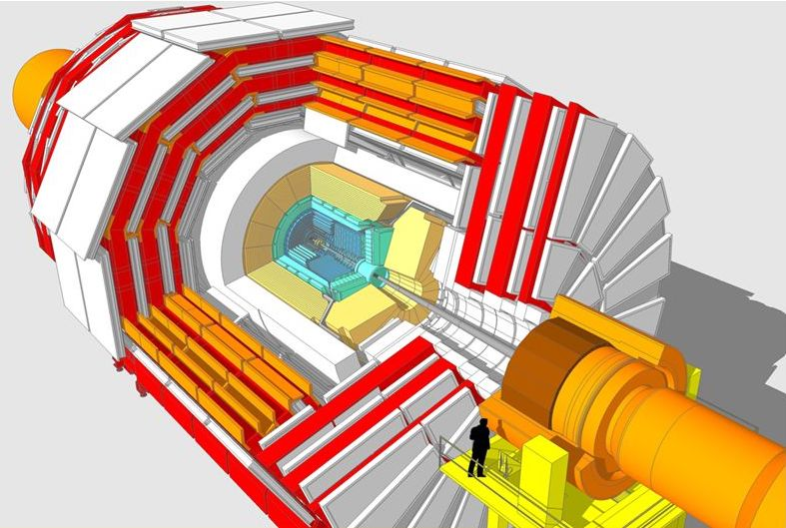
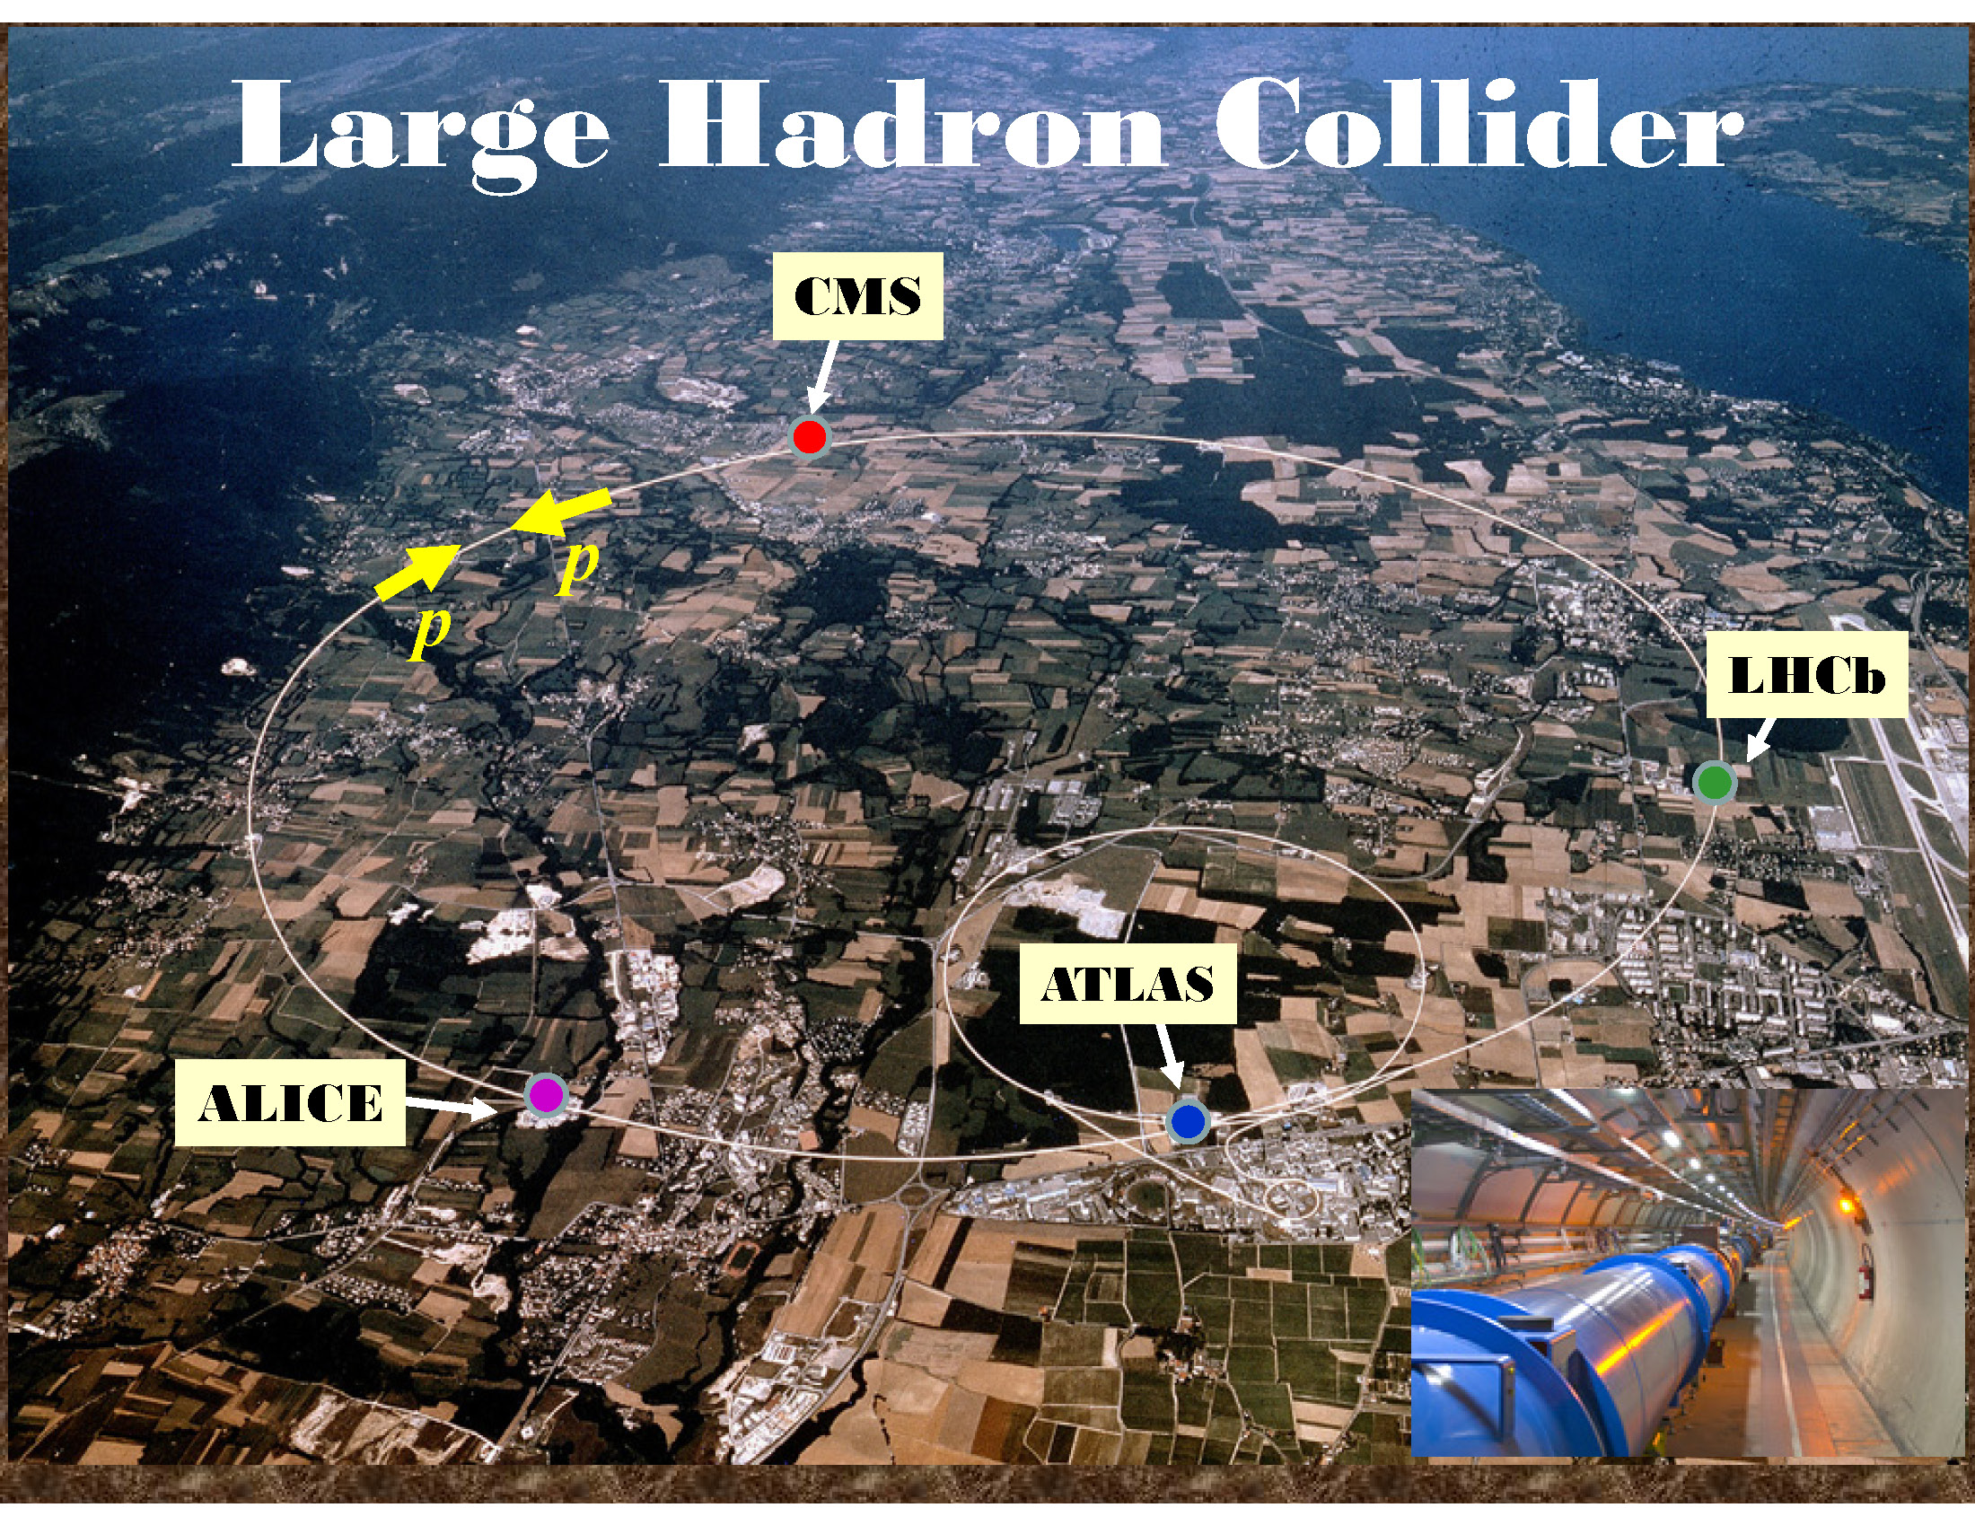
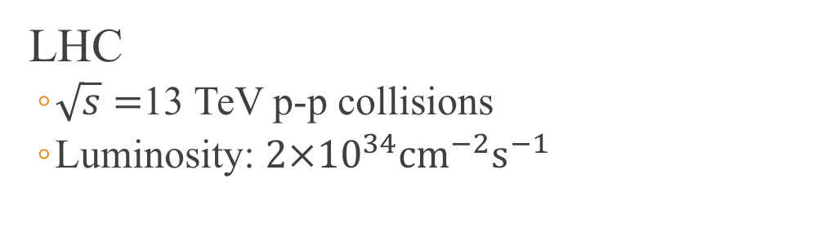
Compact Muon Solenoid (CMS)
LHC
$\sqrt{s}=$13 TeV p-p collisions
Luminosity: $2×{10}^{34}{\text{cm}}^{−2}{\text{s}}^{−1}$

Slide 13
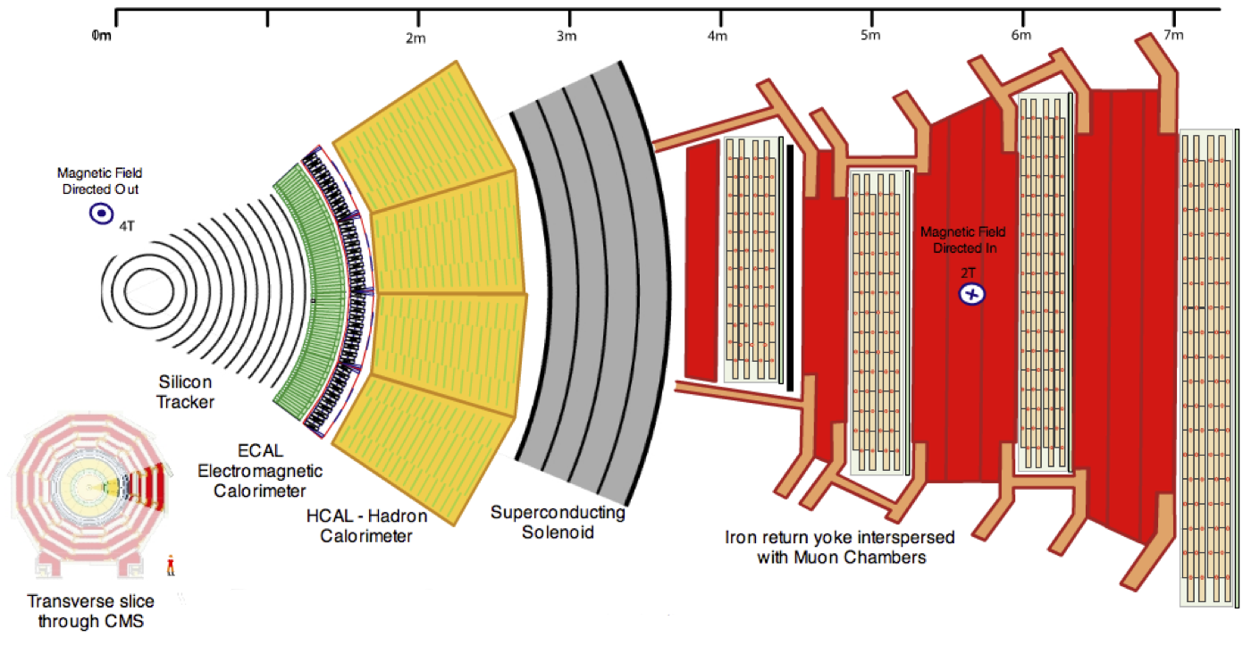
CMS Detector

Slide 14
Muon Interaction

Slide 15
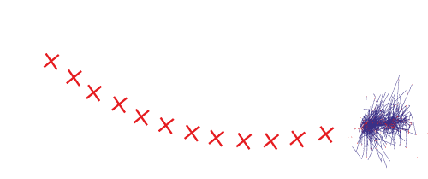
Electron Interaction

Slide 16

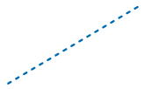
Photon Interaction

Slide 17
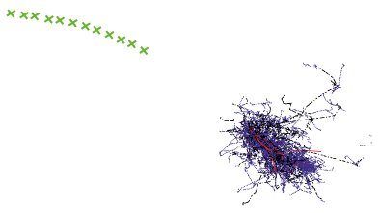
Charged Hadron Interaction

Slide 18
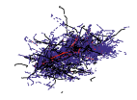

Neutral Hadron Interaction

Slide 19
Outline
Standard Model
What is it?
Dark Matter
Why SUSY?
Compact Muon Solenoid
Different methods of detection
All-hadronic Top Squark Search
Kinematic Variables
Search region design
Background estimation

Slide 20
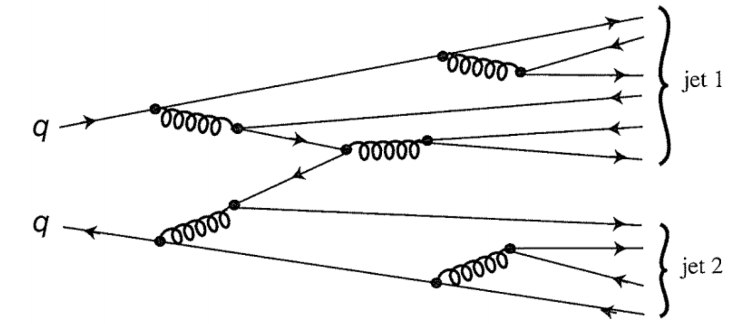
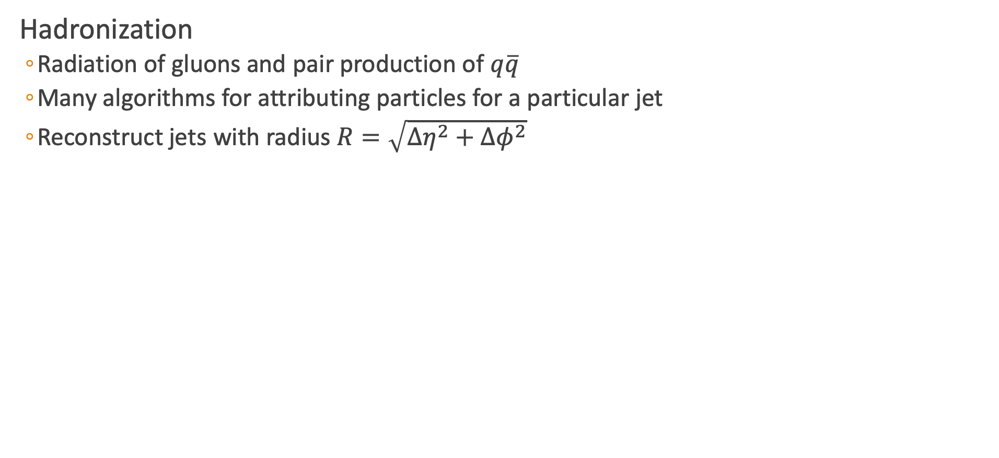
Jet Reconstruction
Hadronization
Radiation of gluons and pair production of $q\overline{q}$
Many algorithms for attributing particles for a particular jet
Reconstruct jets with radius $R=\sqrt{Δη^{2}+Δφ^{2}}$

Slide 21
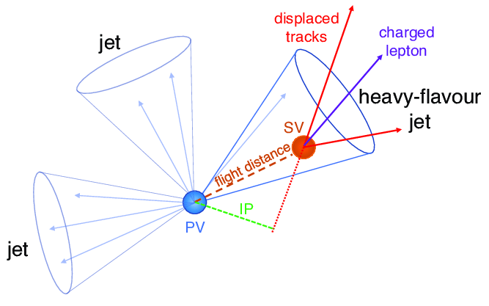
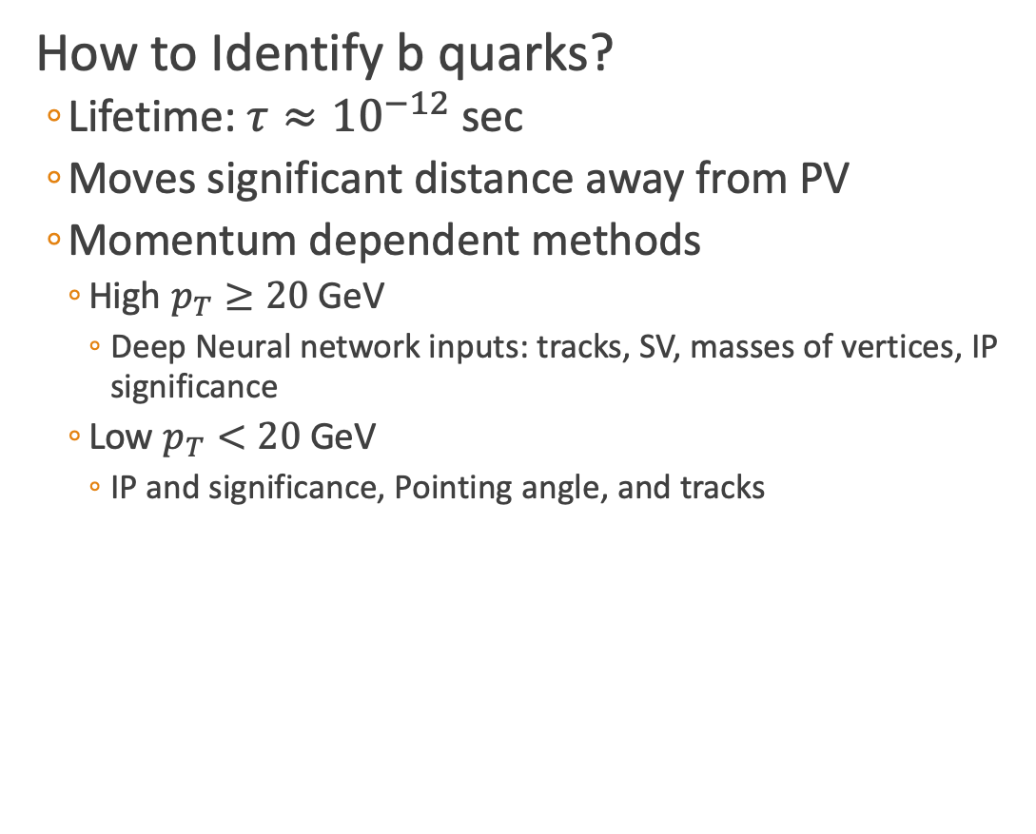
B Tagging
How to Identify b quarks?
Lifetime: $τ≈{10}^{−12}$ sec
Moves significant distance away from PV
Momentum dependent methods
High $p_{T}≥20$ GeV
Deep Neural network inputs: tracks, SV, masses of vertices, IP significance
Low $p_{T}<20$ GeV
IP and significance, Pointing angle, and tracks

Slide 22
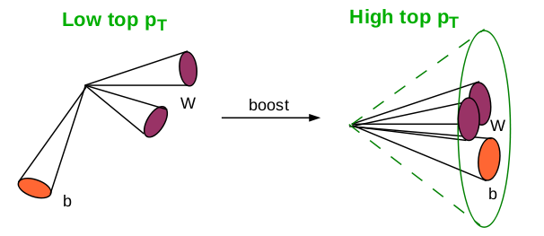
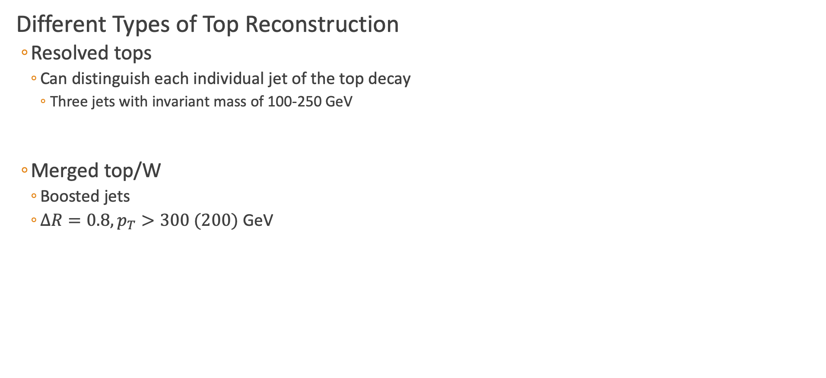
Heavy Object Tagging
Different Types of Top Reconstruction
Resolved tops
Can distinguish each individual jet of the top decay
Three jets with invariant mass of 100-250 GeV
Merged top/W
Boosted jets
$ΔR=0.8, p_{T}>300 (200)$ GeV

Slide 23
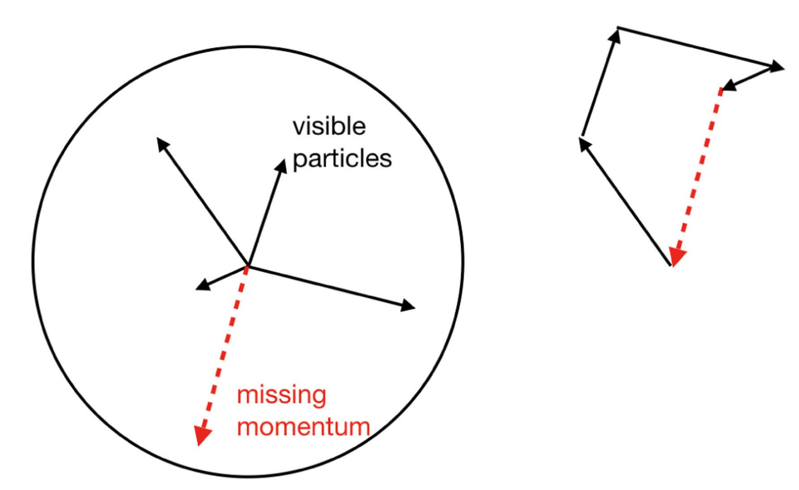
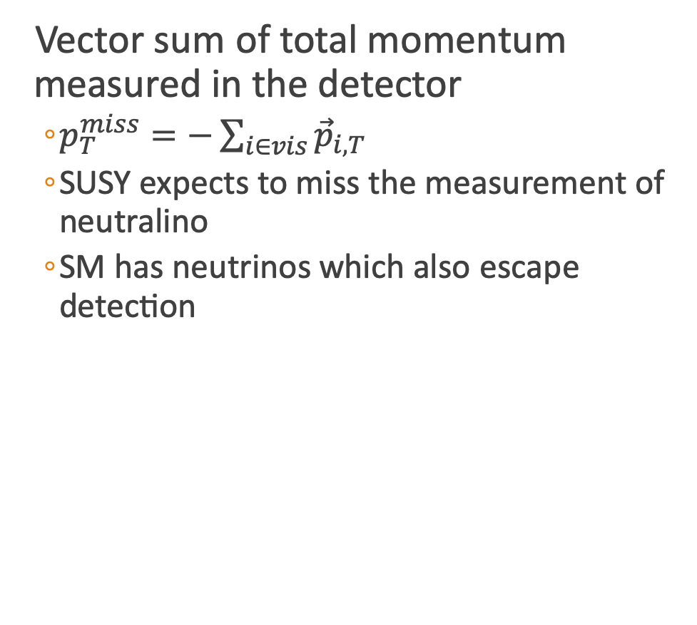
Missing Transverse Momentum
Vector sum of total momentum measured in the detector
$p_{T}^{miss}=−\sum_{i∈vis}{{\vec{p}}_{i,T}}$
SUSY expects to miss the measurement of neutralino
SM has neutrinos which also escape detection
[3]

Slide 24
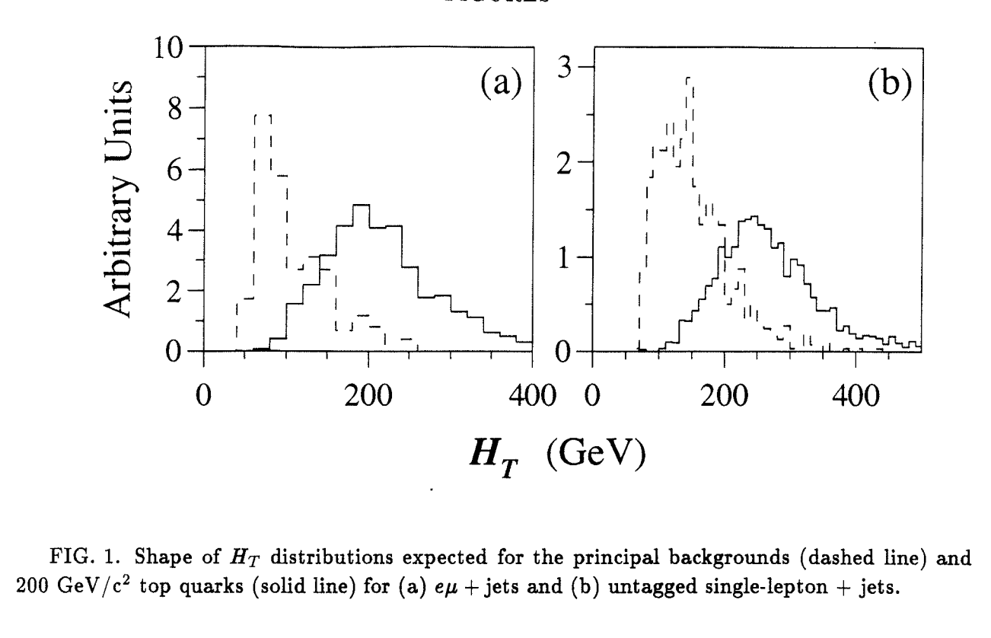
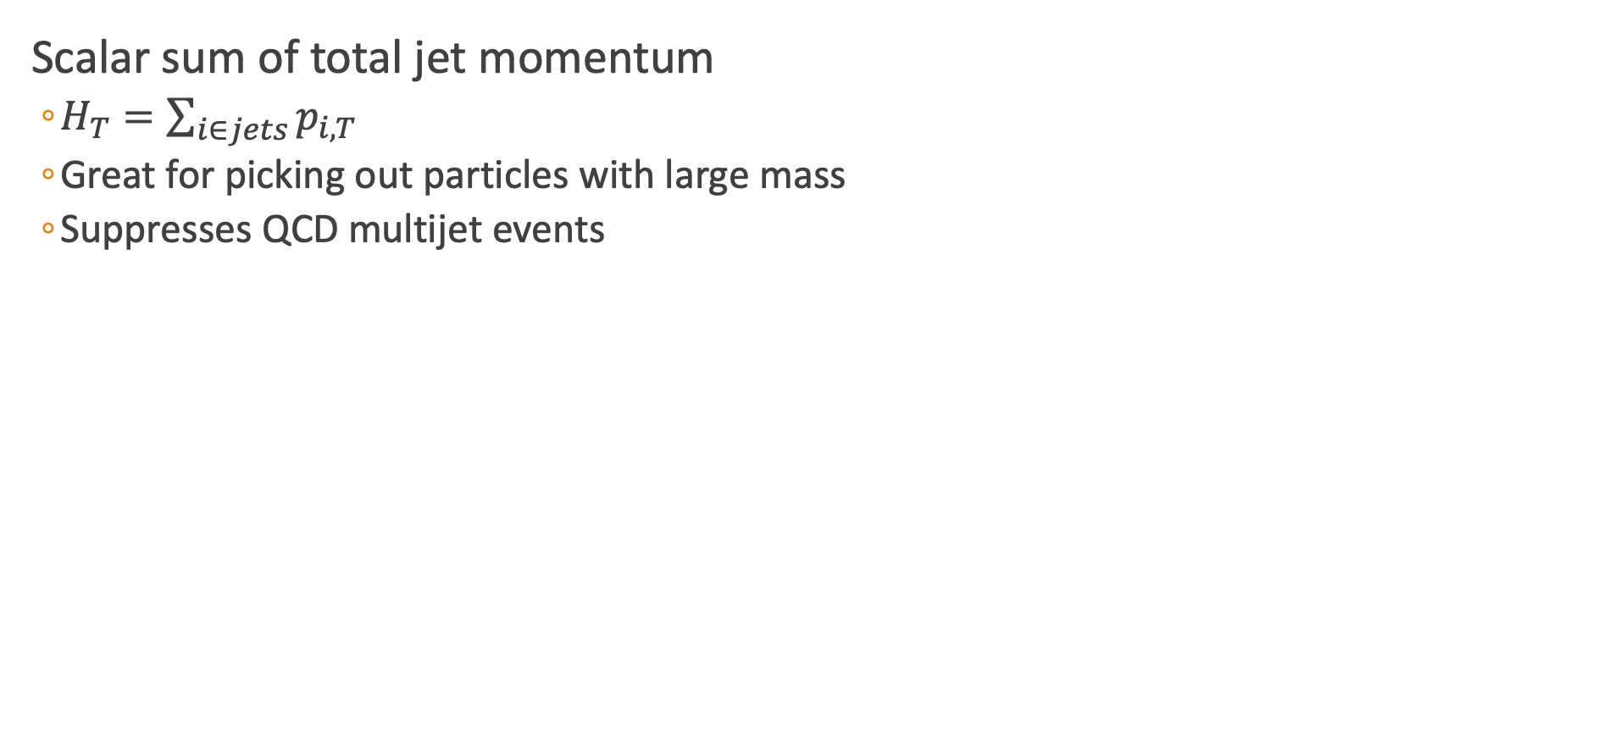
$$H_{T}$$
Scalar sum of total jet momentum
$H_{T}=\sum_{i∈jets}{p_{i,T}}$
Great for picking out particles with large mass
Suppresses QCD multijet events
[4]

Slide 25
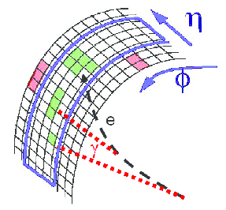
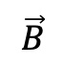
Electron and Muon Identification
Match Track and energy in ECAL (Muon Chambers)
Charged particles leave tracks in the Tracker
“Veto” Electrons
Look at energy deposits in Scintillators
“Loose” Muons
Tracker muons are built “inside out”
Global muons are built “outside in”
Tracker
$$\vec{B}$$
Notes:
Tracker muon: propagate tracks to the muon system with a loose matching to DT or CSC segments, pT > 0.5 and p > 2.5 GeV.
Global muon: matching standalone muon tracks with tracker tracks.
Electrons: (E(brem)/E)=

Slide 26
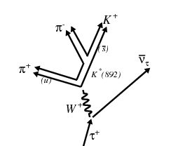
Tau Identification
time
space
Tau Decays are Interesting
17% of decays to leptons
51% is 1 prong hadronic decays
15% is 3 prong hadronic decays
Neural network to identify taus
[5]

Slide 27
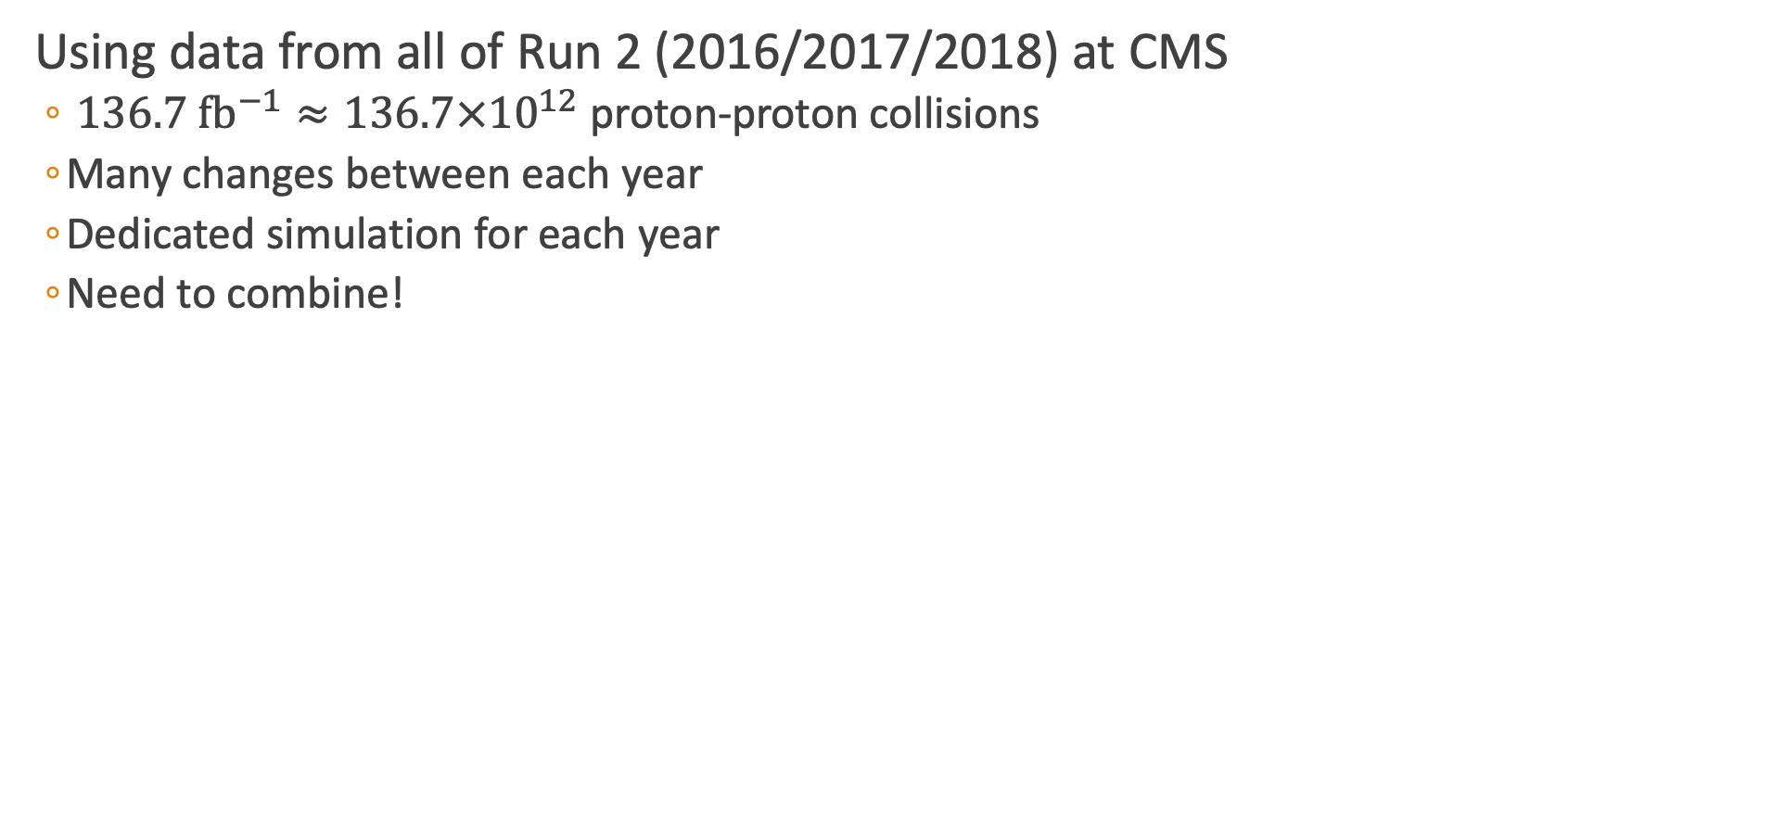
Data Methods
Using data from all of Run 2 (2016/2017/2018) at CMS
$136.7 {\text{fb}}^{−1}≈136.7×{10}^{12}$ proton-proton collisions
Many changes between each year
Dedicated simulation for each year
Need to combine!

Slide 28
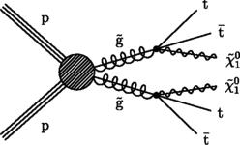
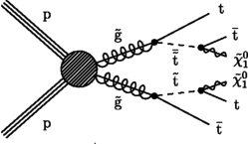
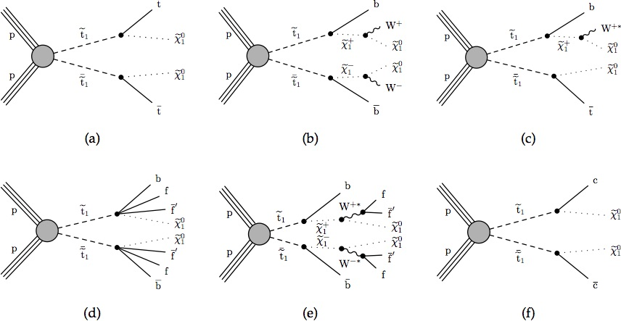


Simplified SUSY Models
Looking at inclusive models for a most general stop search
Gluino Mediated Stop Production
Direct Stop Production

Slide 29




Search Strategy
Categorize low $Δm$ and high $Δm$ by $M_{T}\left(b_{1,2},p_{T}^{miss}\right)$
Low $Δm$
$M_{T}\left(b_{1,2},p_{T}^{miss}\right)<175$ GeV
Veto Tops and W
ISR Tagging
Soft-b tagging
$N_{j}≥2$
$Δφ\left(j_{1},p_{T}^{miss}\right)>0.5, Δφ\left(j_{23},p_{T}^{miss}\right)>0.15$
$\frac{p_{T}^{miss}}{\sqrt{H_{T}}}>10$
High $Δm$
$M_{T}\left(b_{1,2},p_{T}^{miss}\right)>175$ GeV
Top and W tagging
$N_{j}≥5,N_{b}≥1$
$Δφ\left(j_{1234},p_{T}^{miss}\right)>0.5$

Slide 30


Targeted Search Regions
Looking in low and high $Δm$ regions
Top Squark: $Δm=m_{\tilde{t}}−m_{\tilde{χ_{1}^{0}}}$
Gluino: $Δm=m_{\tilde{g}}−m_{\tilde{χ_{1}^{0}}}$
Search Regions
Compressed (low $Δm$)
Uncompressed (high $Δm$)
183 Search regions → 53 low + 130 high

Slide 31


Lost Lepton Background
Standard Model Background
$t\overline{t},W+jets, tW, ttW$
Causes
Lepton fails kinematic cuts
Out of detector acceptance
How to estimate for all of Run 2?

Slide 32


Lost Lepton Background
Standard Model Background
$t\overline{t},W+jets, tW, ttW$
Causes
Lepton fails kinematic cuts
Out of detector acceptance
How to estimate for all of Run 2?

Slide 33

Compare Inclusive Regions
Regions with only low or high $Δm$

Slide 34

Transfer Factor Methods
LL Contribution
Control region (electron/muon): $N_{lep}=1, M_{T}\left(l,p_{T}^{miss}\right)<100$ GeV
Search region: $N_{lep}=0$
$N_{pred}^{LL}=\frac{N_{MC}(0l)}{N_{MC}(1l)}∙N_{data}(1l)$
$TF_{LL}=\begin{matrix}TF_{LL}^{CR−SR}×TF_{LL}^{SR−extrap} \\ \frac{N_{MC}(0l)(N_{j},N_{b},p_{T}^{miss})}{N_{MC}(1l)(N_{j},N_{b},p_{T}^{miss})}×\frac{N_{MC}(1l)(N_{j},N_{b},p_{T}^{miss},N_{t},N_{res},N_{W})}{N_{MC}(0l)(N_{j},N_{b},p_{T}^{miss})}\end{matrix}$
Transfer Factor

Slide 35
Transfer Factor Methods
LL Contribution
Control region (electron/muon): $N_{lep}=1, M_{T}\left(l,p_{T}^{miss}\right)<100$ GeV
Search region: $N_{lep}=0$
$N_{pred}^{LL}=\frac{N_{MC}(0l)}{N_{MC}(1l)}∙N_{data}(1l)$
$TF_{LL}=\begin{matrix}TF_{LL}^{CR−SR}×TF_{LL}^{SR−extrap} \\ \frac{N_{MC}(0l)(N_{j},N_{b},p_{T}^{miss})}{N_{MC}(1l)(N_{j},N_{b},p_{T}^{miss})}×\frac{N_{MC}(1l)(N_{j},N_{b},p_{T}^{miss},N_{t},N_{res},N_{W})}{N_{MC}(0l)(N_{j},N_{b},p_{T}^{miss})}\end{matrix}$
Transfer Factor

Slide 36


Example LL Prediction

Slide 37


Z to Invisible
Events with jets and a Z decaying to two neutrinos
Large $H_{T}$ and $p_{T}^{miss}$, similar to signal
Control Region
$Z→ll+\text{jets}\text{: }R_{Z}$(Z Normalization factor)
Use in low mass $N_{b} \text{and} N_{SV}$
Calculate $t\overline{t}$ normalization $R_{t}$
Photon + jets: $S_{γ}$($p_{T}^{miss}$ shape weight)
Use in low mass $N_{b} \text{and} N_{j}$
Reconstructed $Z \text{or} γ$ is added to $p_{T}^{miss}$ for $Z→ν\overline{ν}$
$$N_{pred}^{Z→ν\overline{ν}}=N_{MC}^{Z→ν\overline{ν}}∙R_{Z}{∙S}_{γ}$$

Slide 38





Comparison of Z Normalization for Muons

Slide 39





Photon Shape Corrections

Slide 40





Comparison of Normalization

Slide 41


QCD Background
Missing Energy from the mismeasurement of jets
QCD Estimation used Transfer Factor method where:
Control Region defined regions with $Δφ(j_{123},Ɇ$) < 0.1
Search Region
Low $Δm:\left|Δφ\left(j_{1},Ɇ\right)\right|>0.5, \left|Δφ\left(j_{23},Ɇ\right)\right|>0.15$
High $Δm:ΔΦ(j_{1234},Ɇ)>0.5$
Transfer Factor
$N_{pred}^{QCD}=\frac{N_{MC}^{QCD}\left(SR\right)}{N_{MC}^{QCD}\left(CR\right)}∙(N_{data}−N_{MC}^{non−QCD})$
Take MC events and do smearing (from 2 leading jets)
Statistical Uncertainty for the TF
Increasing the effective luminosity with a method called “local smearing”
$$TF_{QCD}=\begin{matrix}\frac{N_{MC}\left(SR\right)(N_{j},N_{b},p_{T}^{miss})}{N_{MC}(Δφ_{123}<0.1)(N_{j},N_{b},p_{T}^{miss})}× \\ \frac{N_{MC}(SR)(N_{j},N_{b},p_{T}^{miss},N_{t},N_{res},N_{W})}{N_{MC}(SR)(N_{j},N_{b},p_{T}^{miss})}\end{matrix}$$
Transfer Factor

Slide 42

QCD Smearing Method
Methods based on the jet response (JR) function
Parameterize jet reconstruction
Binned in $p_{T}$ and jet flavor
Local Smearing
Using centrally produced MC, generate an ensemble of smeared event with new reco jet $p_{T}$
Consider the two leading jets
Start at JR for standard MC ( )
Sample in small window ( )
Recalculate variables
Small window $→$ does not bias jet quantities
CMS Work in progress
Probability

Slide 43


QCD Control Region Comparison

Slide 44



Rare Background
3 lepton channels to validate $ttZ$ contribution
Also contribution from diboson (WW, WZ, and ZZ)

Slide 45


Validation Region
Confirm Methods
Validate background estimation
Lower $p_{T}^{miss}$ region
Check agreement
Regions bins definitions

Slide 46

Validation Region
Confirm Methods
Validate background estimation
Lower $p_{T}^{miss}$ region
Check agreement
Regions bins definitions

Slide 47

Higgs Combined Tool Statistics
Method for getting limits on Data, signal, and background
Likelihood function
$ℒ\left(μ,θ\right)=\prod_{i}{\frac{{\left[μ∙s_{i}\left(θ\right)+b_{i}\left(θ\right)\right]}^{n_{i}}}{n_{i}!}e^{−\left[μ∙s_{i}\left(θ\right)+b_{i}\left(θ\right)\right]}}\prod_{κ}{e^{−\frac{1}{2}θ_{κ}^{2}}}$
${\tilde{q}}_{μ}=−2\text{ln}\frac{ℒ\left(μ,{\hat{θ}}_{μ}\right)}{ℒ\left(μ,θ\right)}$
Calculate the confidence levels for each signal region
$p_{μ}=P\left({\tilde{q}}_{μ}≥{\tilde{q}}_{μ}^{obs} | \text{signal}\text{+}\text{background}\right)=\int_{{\tilde{q}}_{μ}^{obs}}^{∞}{f\left({\tilde{q}}_{μ} | μ,{\hat{θ}}_{μ}^{obs}\right)d{\tilde{q}}_{μ}}$
$1−p_{μ}=P\left({\tilde{q}}_{μ}≥{\tilde{q}}_{μ}^{obs} | \text{background}\text{−}\text{only}\right)=\int_{{\tilde{q}}_{μ}^{obs}}^{∞}{f\left({\tilde{q}}_{μ} | 0,{\hat{θ}}_{0}^{obs}\right)d{\tilde{q}}_{μ}}$
$CL_{s}\left(μ\right)=\frac{p_{μ}}{1−p_{b}}$
Look for $CL_{s}=0.05$
But how do we input all of this?

Slide 48
Limits

Slide 49

Limits

Slide 50
Backup

Slide 51



${\tilde{t}}_{1}$: Dynamic Reason to be at bottom of sParticles
Quark left and right superpartners can strongly mix to form mass eigenstates
$M_{\tilde{t_{1}}}^{2}=\left(\begin{matrix}{\tilde{M}}_{Q_{3}}^{2}+M_{t}^{2}+M_{Z}^{2}\left(\frac{1}{2}−\frac{2}{3}\sin^{2}{θ_{W}}\right)cos2β & v\left(a_{t}^{∗}sinβ−μy_{t}cosβ\right) \\ v\left(a_{T}^{∗}sinβ−μy_{t}cosβ\right) & {\tilde{M}}_{{\overline{u}}_{3}}^{2}+M_{t}^{2}+\frac{2}{3}M_{Z}^{2}\sin^{2}{θ_{W}cos2β}\end{matrix}\right)$
Strong mixing in the stop sector
Could lead to ${\tilde{t}}_{1}$being the lightest squark
Notes:
Y_t is the Yukawa coupling(interaction between a scalar field and Dirac field),

Slide 52


The Tracker Detector
Outer Tracker
Active area: 200 ${\text{m}}^{2}$, 15148 modules
10 layers in barrel region
9 + 3 in inner disks and endcaps
Analog readout
Phase 1 Pixel Tracker
4 barrel layers
3 endcap disks on each side
124 million pixel channels
Digital Readout

Slide 53




Phase 1 Pixels
Replaced in winter 2016/2017
Approximately 1 m long
Designed for peak luminosity of $2.5×{10}^{34}{ \text{cm}}^{−2}{\text{s}}^{−1}$ with 50 ns bunch crossings
Analog $→$ digital
New data acquisition (DAQ)
DCDC powering
${\text{CO}}_{2}$ cooling
Light weight
Cost effective
Layer 1 closer to beam line
43 mm to 30 mm
Layer 4 extends to 160 mm

Slide 54


Anti-kT Algorithm
Distance calculation
$d_{ij}=\text{min}(k_{Ti}^{−2},k_{Tj}^{−2})\frac{{\left(y_{i}−y_{j}\right)}^{2}+{\left(φ_{i}−φ_{j}\right)}^{2}}{R^{2}}$
$d_{iB}=k_{Ti}^{−2}$
Infrared safe
Circular jet area
Notes:
Infrared safe: reconstruction is unaffected by soft radiation of photons
Jet area: unaffected by soft radiation, low pT photons will not have a min from the above
P = 1: Inclusive kT algorithm
P = 0: Inclusive Cambridge/Aachen algorithm

Slide 55

Stop Cross Section
Cross section-probability that two particles will collide and react a certain way

Slide 56
Identification of Leptons
Isolation Methods
Electrons and muons are isolated
Measurements in Electromagnet Calorimeter and Muon Chambers, respectively
Using recommendations by CMS
Hadronic Taus
Looking at isolated charged hadrons
Boosted Decision Trees (BDT)
Training is matched gen level taus from 2017 TTbar simulation
Good discrimination between taus and other particles
CMS Work in progress

Slide 57

Tau MVA
Comparison of three hadronically decaying tau tagging methods
Custom MVA identifying charged hadron candidates
Custom BDT trained on ttbar 2017 samples to identify hadronically decaying taus
Isotrack using cut-based methods
Isotrack+tauPOG identification
$\text{Veto} \text{percent} =1 − \frac{N_{τ=0}}{N_{τ≥0}}$
$\text{Efficiency} =\frac{(N_{τ>0} \&\& N_{τ>0}^{gen})}{N_{τ>0}^{gen}}$
 | ttbar 1-lep Background |  | T2tt(850, 100) |  | T2tt(500, 325)
Methods | Veto Percentage | Veto Efficiency | Veto Percentage | Veto Efficiency | Veto Percentage | Veto Efficiency
Custom MVA | 32.2% | 57.7% | 6.5% | 10.9% | 27.6% | 39.4%
IsoTrack | 21.3% | 37.9% | 2.6% | 6.6% | 8.9% | 22.6%
IsoTrack + TauPOG | 29.0% | 49.1% | 7.2% | 22.6% | 14.6% | 37.3%

Slide 58

Baseline Selection
Lepton Selection
Veto ID electron: $p_{T}>5$ GeV, $\left|η\right|<2.5$
Loose muon: $p_{T}>5$ GeV, $\left|η\right|<2.5$
IsoTrack: cut based charged PF candidate
TauPOG: $p_{T}>20$ GeV, $\left|η\right|<2.4$, medium working point
$N_{j}\left(p_{T}>20 \text{GeV}\right)≥2,\left|η\right|<2.4$
$Δφ\left(j_{1},p_{T}^{miss}\right)>0.5,Δφ\left(j_{23},p_{T}^{miss}\right)>0.15$
$p_{T}^{miss}>250$ GeV
$H_{T}>300$ GeV
HEM Veto: $η\left[−3,−1.4\right], φ\left[−1.57,−0.87\right],p_{T}>20$ GeV applied to jets, electrons, and photons
Bjets: DeepCSV medium working point
W/Top: deepAK8 tight working point
Deep Resolved Top: tight working point
Scale Factors: PUWeights, BtagWeights, resTop/Top/W, soft btaggin, ISRWeights (2016), PrefireWeights (2016/2017) for all backgrounds

Slide 59

Low Mass Region

Slide 60

High Mass Region

Slide 61
Lost Lepton Inclusive Low DM

Slide 62
Lost Lepton Inclusive High DM

Slide 63

Z Normalization
Calculate the normalizations
$\left[\begin{matrix}Data_{on−Z} \\ Data_{off−Z}\end{matrix}\right]=\left[\begin{matrix}MC_{on−Z}(Z→ll) & MC_{on−Z}(t\overline{t}) \\ MC_{off−Z}(Z→ll) & MC_{off−Z}(t\overline{t})\end{matrix}\right]∙\left[\begin{matrix}R_{Z} \\ R_{T}\end{matrix}\right]$
Contributions from tZ, ttZ, WZ, and ZZ in Rz
Contributions from tW, ttW, and WW in Rt

Slide 64

Low DM Validation Region

Slide 65

High DM Validation

Slide 66

Datacard Calculation

Slide 67
Datacard Calculation

Slide 68
Datacard Calculation

Slide 69
Datacard Calculation

Slide 70
Datacard Calculation

Slide 71

Example Calculation for Single Bin
Total yield of background
N=3042.65(LL)+7457.98(Znunu)+690.827(QCD)+0.390779(ttZ)+196.672(Diboson)
N=11388.52
Stat. Uncertainty = 0.0066(LL)+0.0027(Znunu)+0.03078(QCD)+0.10877(ttZ)+0.03485(Diboson)
Stat. Uncertainty = 68.40 (sum of weights squared)
$μ≅\frac{\sum{w_{i}x_{i}}}{\sum{w_{i}}}$ where $x_{i}=$ uncertainty of stat uncertainty
Simple(independent) Syst. Uncertainty =

